Slide 1
HOUSING PRICE PREDICTION
BY-Neetu Bam
Batch No-DS0622

Slide 2
CONTENT
*Over View
*Problem statement
*Problem Understanding
*Exploratory Data Analysis
*Visualization
*Steps and Assumptions
*Model Building
*Variation Inflation Factor
*Cross Validation Score
*Hyper Parameter Tuning
*Conclusion

Slide 3
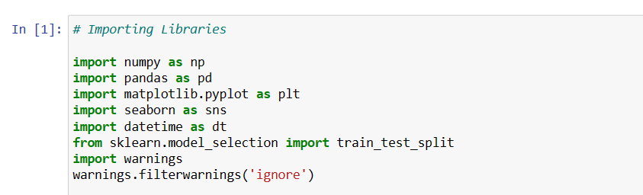
Import necessary Liabraries

Slide 4
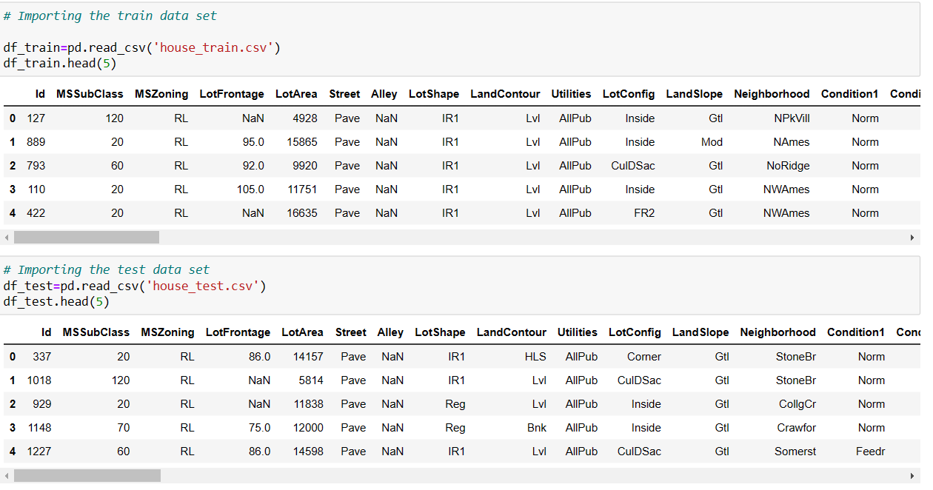
Import Train And Test Data

Slide 5
EDA
First I check Data shape,column,describe,Null Data,Unique Data,Heat map.After that I do Data Visualization

Slide 6
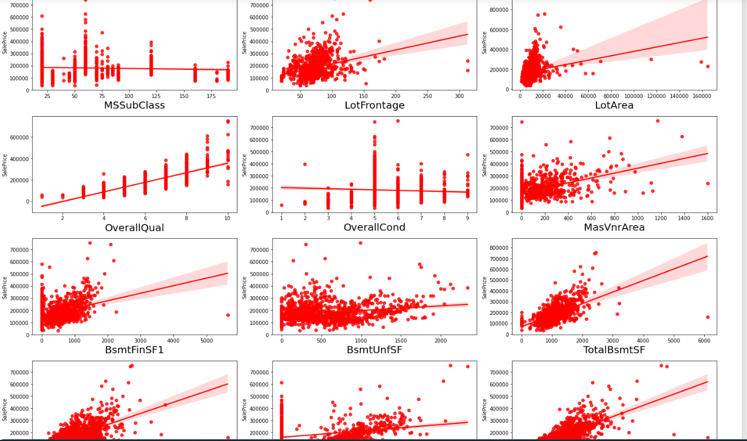
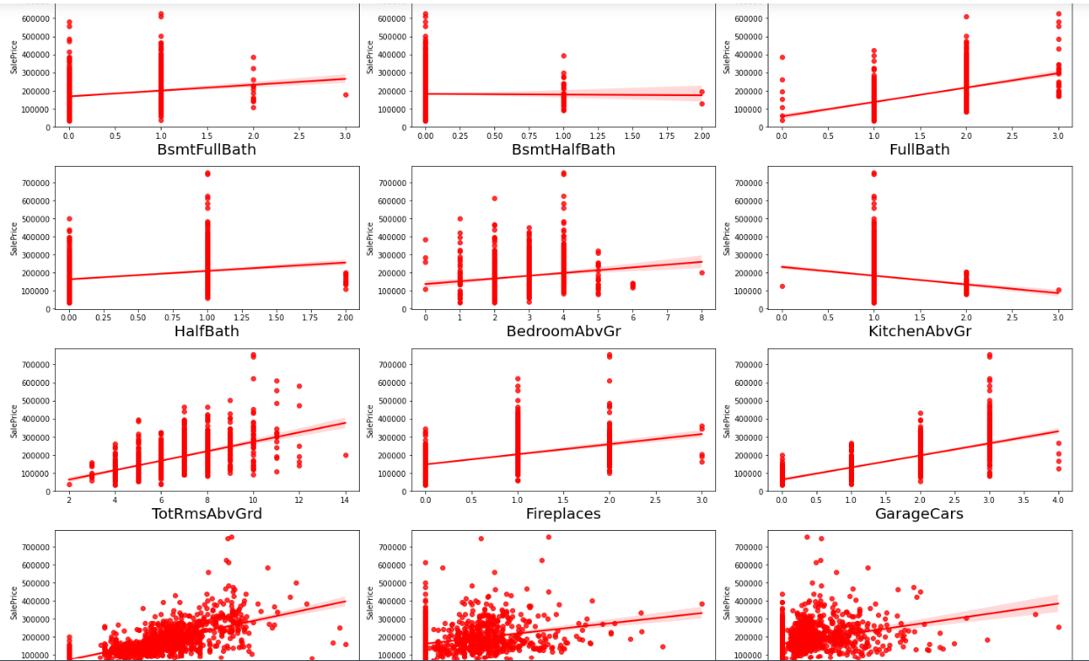
Visualization of Regression Plot

Slide 7
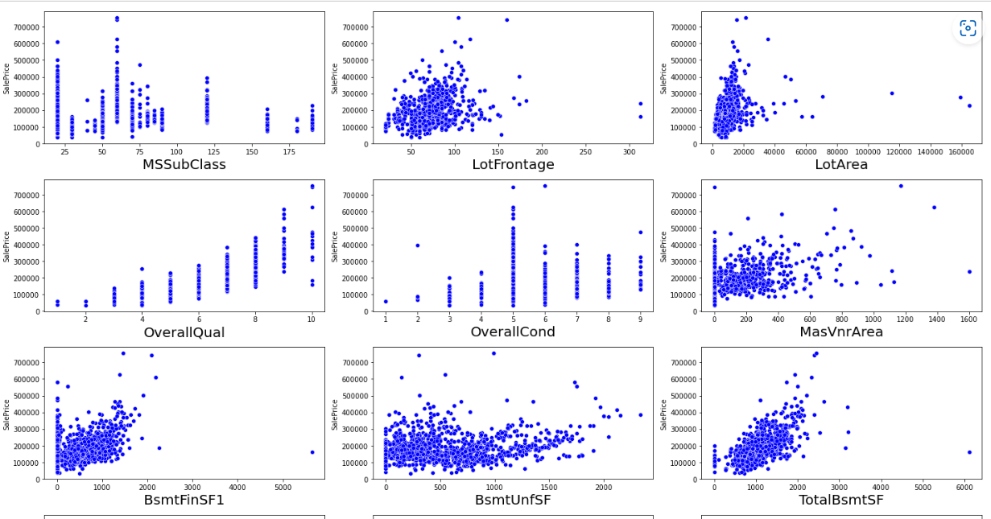
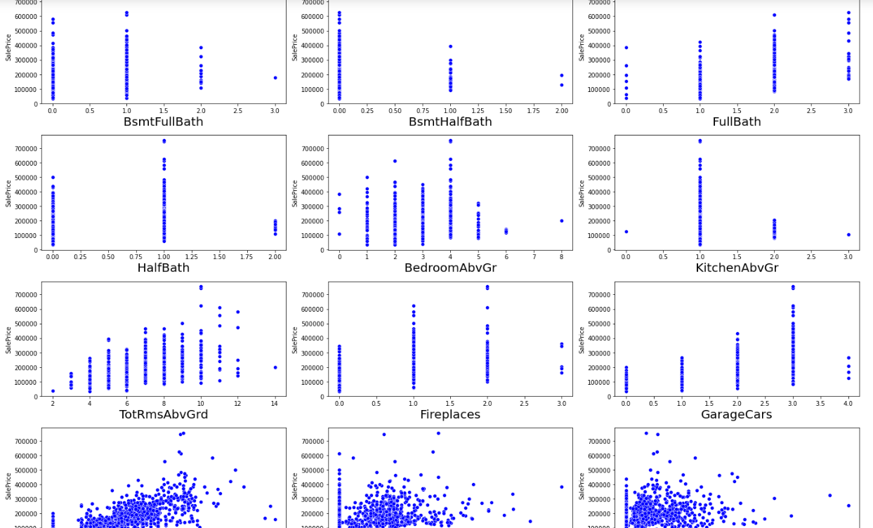
Visualization of Scatterplot for Numerical Data

Slide 8
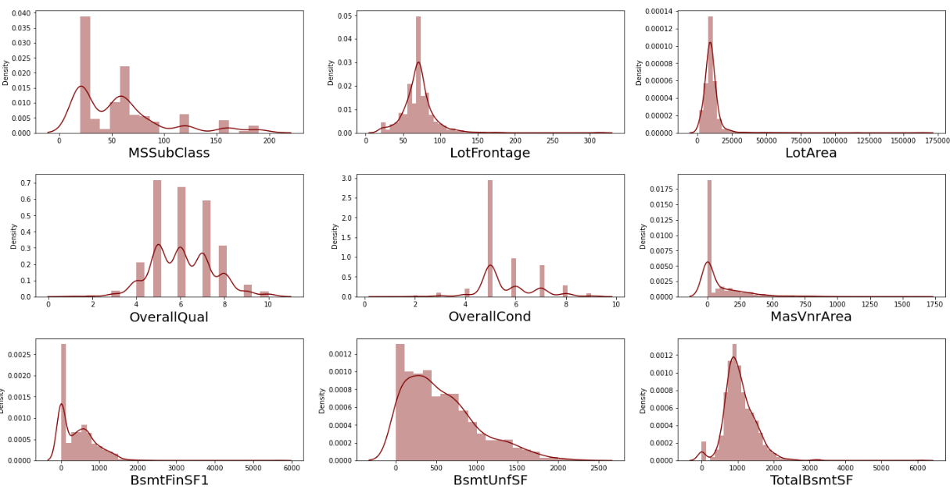
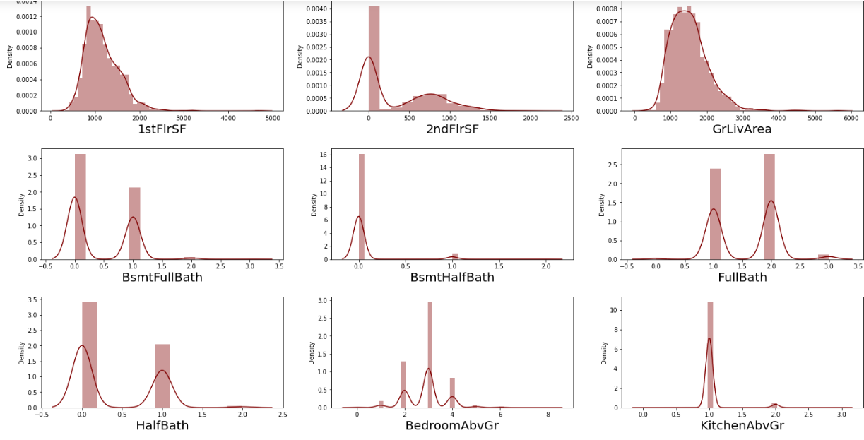
Distribution Plot of Numerical data for Train Data

Slide 9
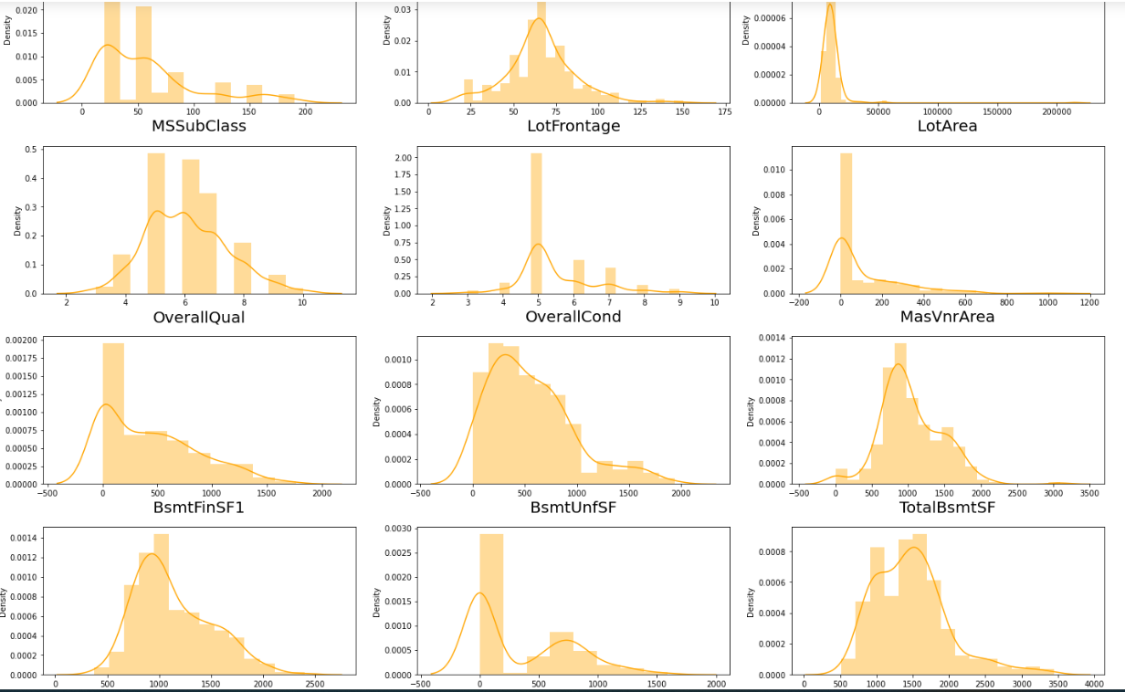
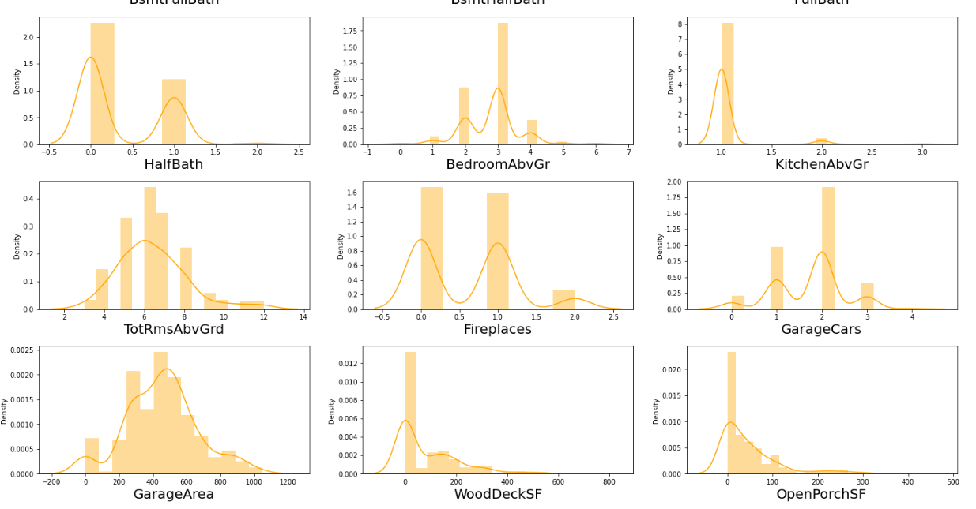
Distribution Plot of Numerical data for Test Data

Slide 10
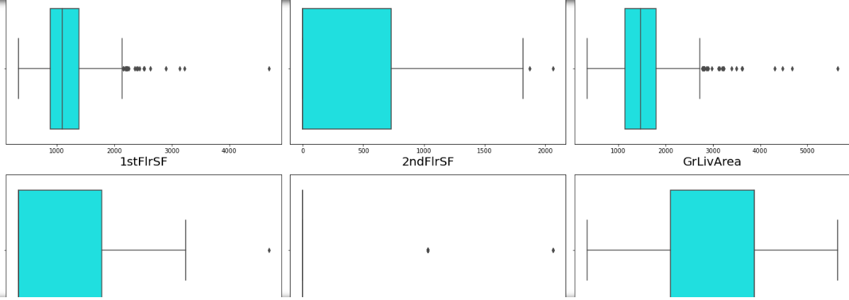
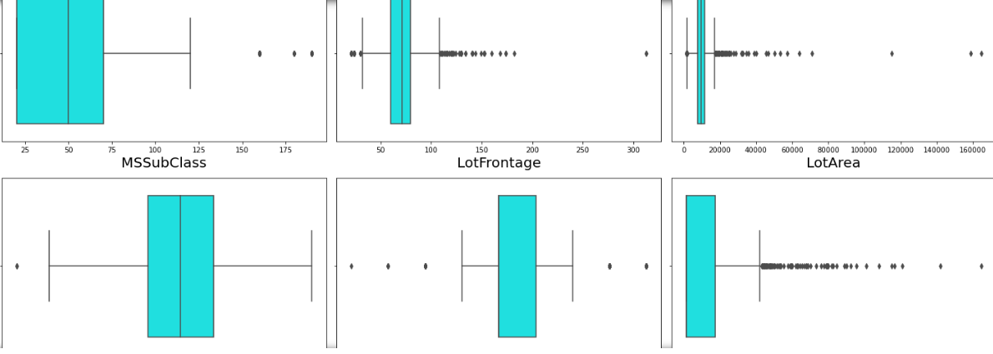
Outliers in Train Data

Slide 11
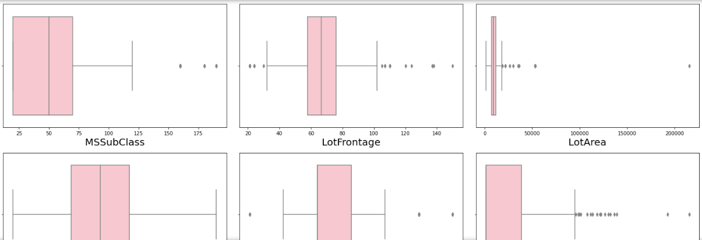
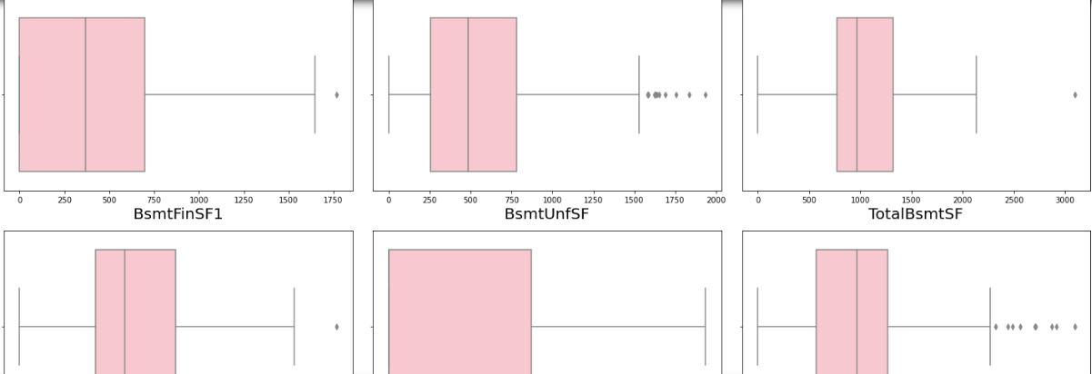
Outliers in Test Data

Slide 12

Correlation of Train Data

Slide 13
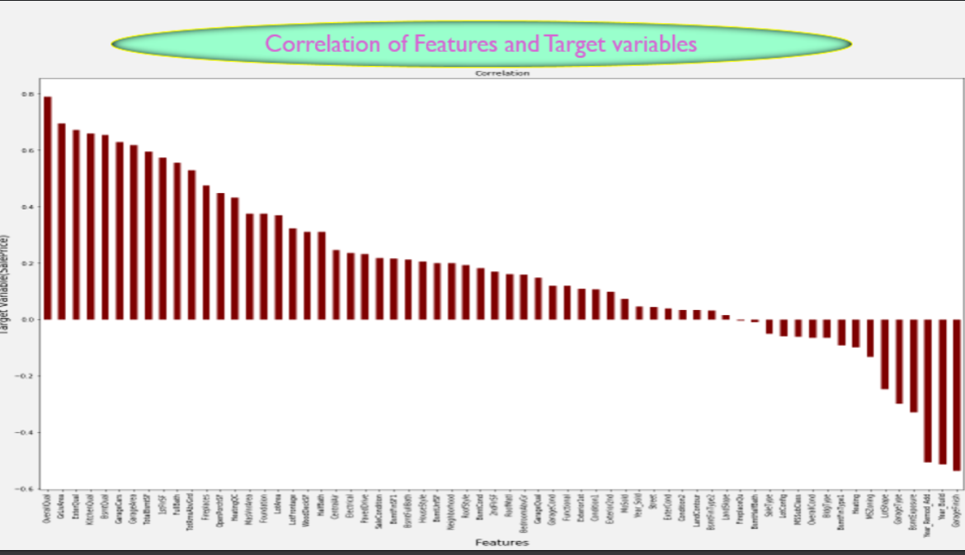

Slide 14
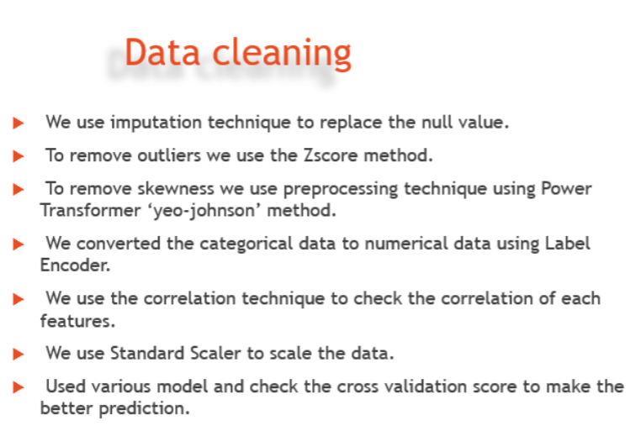

Slide 15
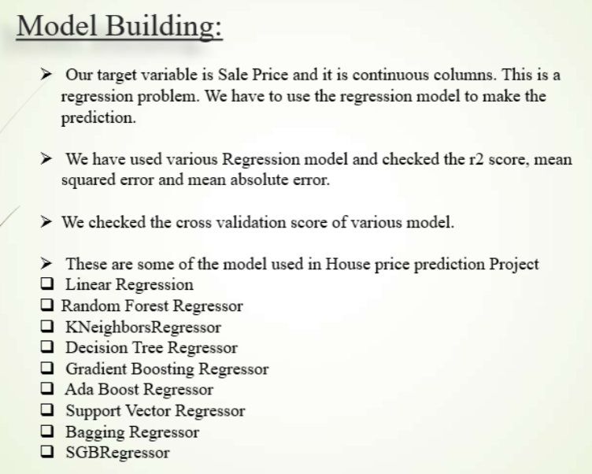

Slide 16
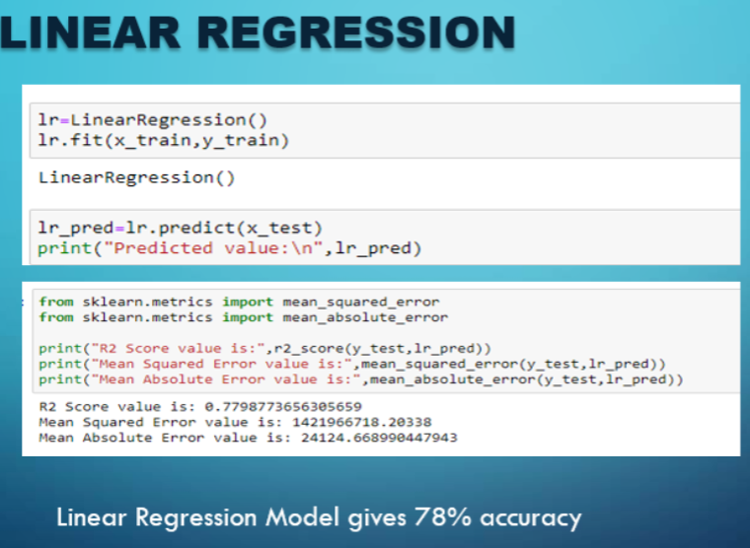

Slide 17
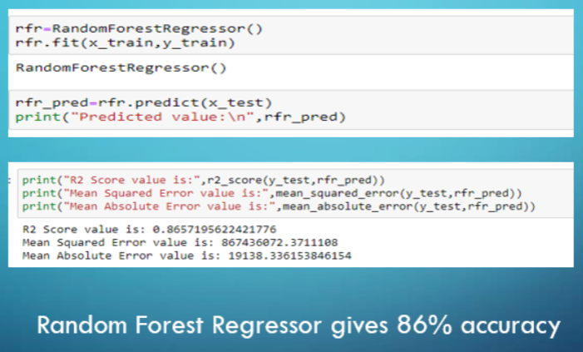
Random Forest Regressor

Slide 18
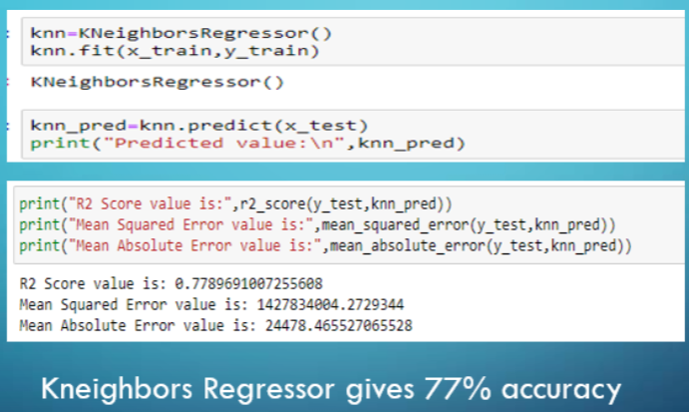
KNeighbors Regressor

Slide 19
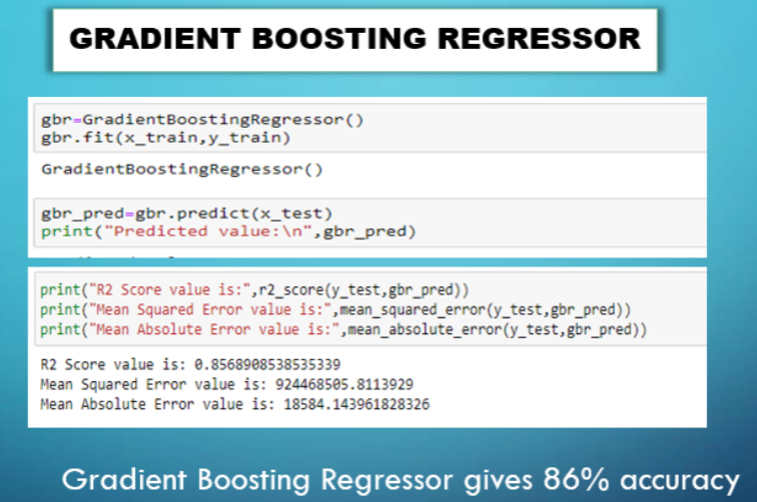

Slide 20
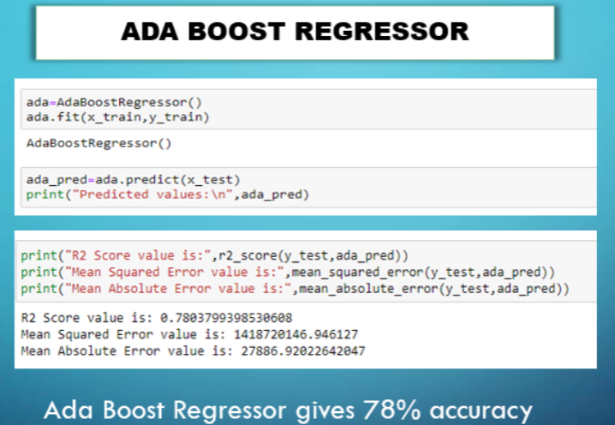

Slide 21
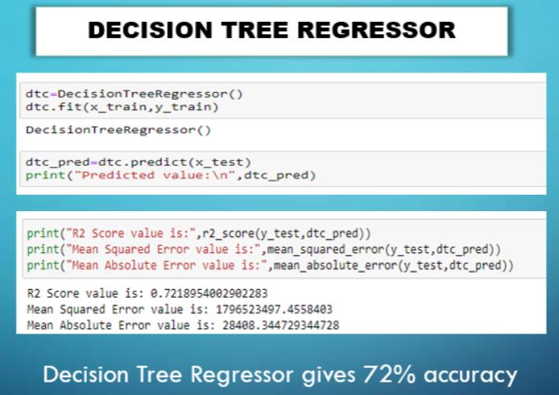

Slide 22
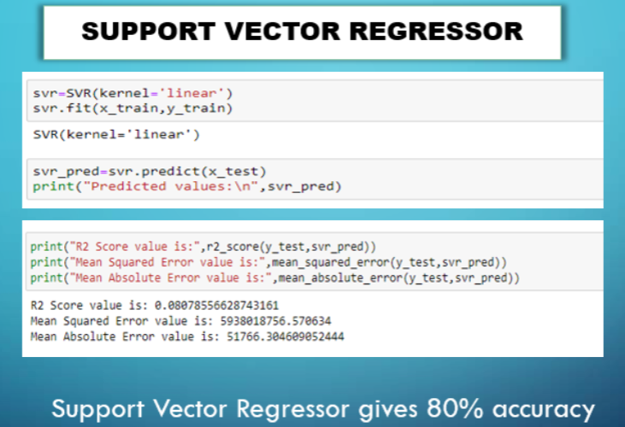

Slide 23
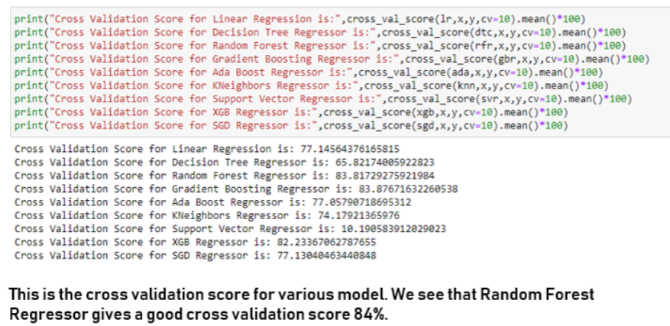
CROSS VALIDATION SCORE

Slide 24
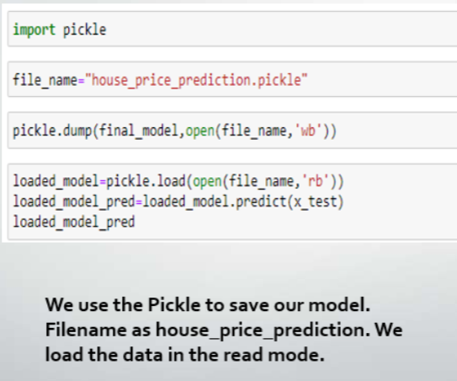
SAVING THE MODEL

Slide 25
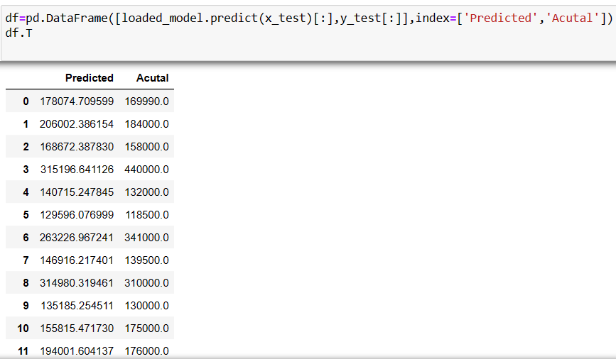
PREDICTED AND ACTUAL VALUE

Slide 26
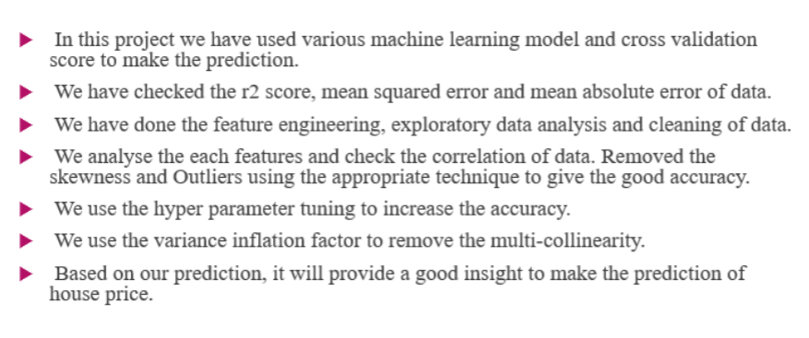
CONCLUSION

